Slide 1

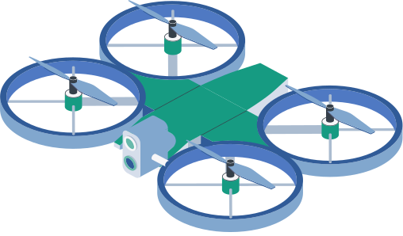

LEVERAGING ARTIFICIAL INTELLIGENCE IN DRONE DELIVERY SYSTEMS
LCE 116
Dimitris Chambi - 30727
George Karios - 30738
Lecturer: Dimitrios Boglou

Slide 2

TABLE OF CONTENTS
01
02
03
WHAT ARE
AI-DRIVEN DRONE DELIVERIES?
BUSINESS
APPLICATIONS & BENEFITS
INTRODUCTION
04
05
06
CHALLENGES & CONSIDERATIONS
CONCLUSION
BIBLIOGRAPHY

Slide 3
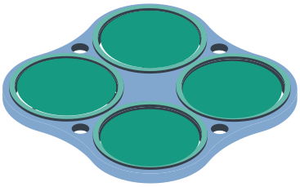


01
INTRODUCTION

Slide 4

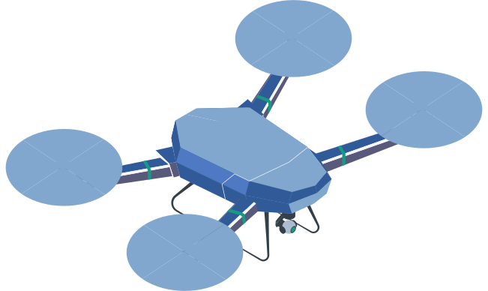
PARTS OF A DRONE
MOTOR
PROPELLER
Powers the propellers and controls movement.
Spins to lift and move the drone.
RECEPTOR
Receives signals and sends them to the AI for decisions.
LANDING GEAR
Protects the drone during takeoff and landing.
CAMERA
Used by the AI to see and make flight decisions.
DELIVERY PACKAGE
The Package that the Drone Delivers to the Client.

Slide 5
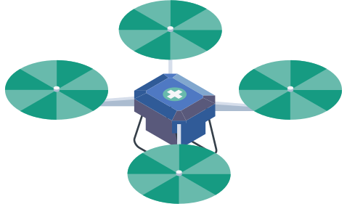
  2.14B online shoppers in 2021→Demand for faster deliveries
  Businesses race to meet soaring expectations for deliveries
PURPOSE
  Cut costs, speed last-mile delivery with AI-driven drones
  Key AI features: navigation, real-time routing, predictive analytics
RELEVANCE
  Gain a competitive edge & attract tech-savvy customers
  Boost customer satisfaction with faster, reliable deliveries
  Promote innovation & sustainability in modern business

Slide 6

02
WHAT ARE AI-DRIVEN DRONE DELIVERIES?

Slide 7
DEFINITION
  Drones (unmanned aerial vehicles) equipped with AI for autonomous or semi-autonomous flight, route optimization, and decision-making.
Computer Vision:
  Uses cameras & sensors to detect obstacles, read terrain, and ensure safe navigation.
Machine Learning & Deep Learning:
  Real-time data processing for route optimization, obstacle avoidance, and predictive maintenance.
Edge Computing
  Onboard processing to reduce latency and make faster decisions mid-flight.

Slide 8
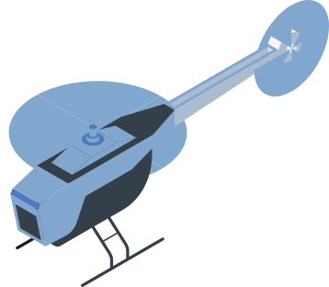
03
BUSINESS
APPLICATIONS & BENEFITS

Slide 9


Last-Mile Delivery Optimization
Supply Chain
& Logistics
  Cuts delivery time with AI-optimized routes (avoids traffic)
  Reaches remote locations quickly for on-time delivery
  Automates internal logistics (e.g. warehouse transfers)
  Streamlines inventory movement & fulfillment
  Lowers costs (fuel, labor)

Slide 10


Data-Driven Decision Making
Competitive Advantages
  Collects real-time delivery data
  AI insights for route optimization & resource allocation
  Enhances forecasting & continuous improvements
  Distinguishes businesses with cutting-edge service
  Faster deliveries → higher customer satisfaction
  First-mover advantage & innovative brand image

Slide 11

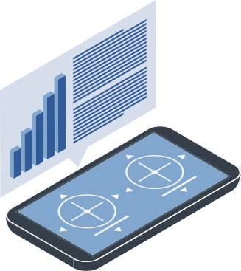
04
CHALLENGES & CONSIDERATIONS

Slide 12
Regulations & Airspace Control
Infrastructure & Tech Gaps
  Varying rules on where and how drones can fly
  Compliance with aviation authorities is crucial
  Need secure landing hubs, recharging stations, or “drone lanes”
  AI relies on high-quality data and stable communications
Security & Privacy
Public Acceptance
  Potential hacking or misuse of drones
  Privacy concerns over flights near private property
  Noise, safety worries, and public trust factor into success
  Address local concerns to gain community support

Slide 13
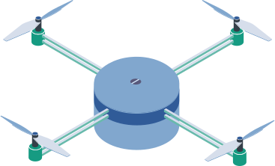
05
CONCLUSION

Slide 14
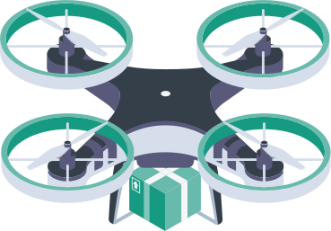


Summary
Looking Ahead
  AI-driven drone delivery can drastically increase speed, reduce costs, and boost competitive advantage.
  As technology matures and regulations adapt, drones could become standard in supply chain operations.
Call to Action
  Urge business leaders, policymakers, and customers to invest in research, infrastructure, and pilot programs to refine drone technology and expand its benefits.

Slide 15
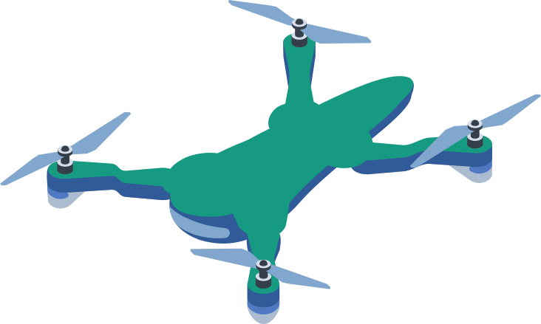
06
BIBLIOGRAPHY & REFERENCES

Slide 16

  [1] L. C. Dieu, “AI and Autonomous Drones: Transforming Delivery and Transportation | SmartDev,” SmartDev, Sep. 17, 2024. https://smartdev.com/ai-and-autonomous-drones-transforming-delivery-and-transportation/ (accessed Apr. 04, 2025).
  [2] SwissCognitive Guest Blogger, “How AI Is Transforming Drone Delivery,” SwissCognitive | AI Ventures, Advisory & Research, Aug. 13, 2024. https://swisscognitive.ch/2024/08/13/how-ai-is-transforming-drone-delivery/ (accessed Apr. 04, 2025).
  [3] F. Magdolna, “Is Drone Delivery Artificial Intelligence? (April 2025),” Fly Eye, Jan. 19, 2024. https://www.flyeye.io/is-drone-delivery-artificial-intelligence/# (accessed Apr. 04, 2025).
  [4] D. Caballero-Martin, J. M. Lopez-Guede, J. Estevez, and M. Graña, “Artificial Intelligence Applied to Drone Control: A State of the Art,” Drones, vol. 8, no. 7, pp. 296–296, Jul. 2024, https://doi.org/10.3390/drones8070296.(accessed Apr. 04, 2025).

Slide 17
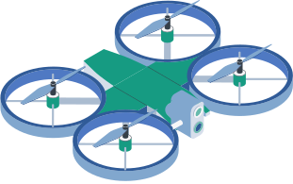
  [5] T. Verbitskaya, “AI Drones Streamlining Delivery and Supply Chain Management,” Keymakr, Jan. 20, 2025. https://keymakr.com/blog/untitled-4/ (accessed Apr. 05, 2025).
  [6] Y. ADEOYE, F. ONOTOLE, T. OGUNYANKINNU, G. AIPOH, A. OSUNKANMIBI, and J. EGBEMHENGHE, “Artificial Intelligence in Logistics and Distribution: The function of AI in dynamic route planning for transportation, including self-driving trucks and drone delivery systems,” World Journal of Advanced Research and Reviews, vol. 25, no. 2, pp. 155–167, Feb. 2025, doi: https://doi.org/10.30574/wjarr.2025.25.2.0214.(accessed Apr. 05, 2025).
  [7] W. Walker, “Drones, AI and more: 5 Last-mile delivery trends to watch | Roadie,” Roadie, Oct. 28, 2024. https://www.roadie.com/blog/2024/10/drones-ai-and-more-5-last-mile-delivery-trends-to-watch-ent (accessed Apr. 05, 2025).
  [8] D. Amicone, A. Cannas, A. Marci, and G. Tortora, “A Smart Capsule Equipped with Artificial Intelligence for Autonomous Delivery of Medical Material through Drones,” Applied Sciences, vol. 11, no. 17, p. 7976, Aug. 2021, doi: https://doi.org/10.3390/app11177976.(accessed Apr. 05, 2025).

Slide 18
  [9] R. Nunkoo, R. Pillai, Brijesh Sivathanu, and N. P. Rana, “Drivers and inhibitors of consumers’ adoption of AI-driven drone food delivery services,” International Journal of Hospitality Management, vol. 123, pp. 103913–103913, Sep. 2024, doi: https://doi.org/10.1016/j.ijhm.2024.103913.(accessed Apr. 06, 2025).
  [10] A. S. Shuaibu, A. S. Mahmoud, and T. R. Sheltami, “A Review of Last-Mile Delivery Optimization: Strategies, Technologies, Drone Integration, and Future Trends,” Drones, vol. 9, no. 3, p. 158, Feb. 2025, doi: https://doi.org/10.3390/drones9030158.(accessed Apr. 06, 2025).

Slide 19

THANK YOU!
DO YOU HAVE ANY QUESTIONS?

